Slide 1
Help Wanted Online A real-time measure of job postings
March 2023
Office of Research Connecticut Department of Labor
Connecticut Department of Labor – Research Office 200 Folly Brook Blvd. Wethersfield, CT 06109
Help Wanted Online

Slide 2
What is HWOL?
The Conference Board Help Wanted Online® Data Series (HWOL) measures the number of new, first-time Online job postings and jobs reposted from the previous month for over 50,000 Internet job boards, corporate boards and smaller job sites that serve niche markets and smaller geographic areas. This document contains information on weekly new job ads from the week ending March 4th, 2023 and monthly total job ad counts for February 2023.
Connecticut Department of Labor – Research Office 200 Folly Brook Blvd. Wethersfield, CT 06109
Help Wanted Online

Slide 3
Upcoming Release Dates
Monthly Report: April, 12th, 2023 Weekly New Ads Report: Updated every Friday
Connecticut Department of Labor – Research Office 200 Folly Brook Blvd. Wethersfield, CT 06109
Help Wanted Online

Slide 4
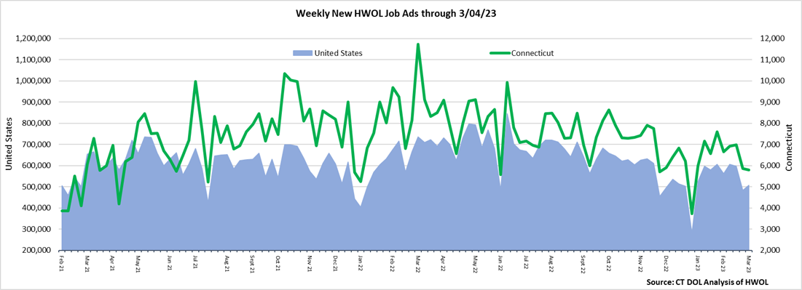
Statewide Weekly New Job Ads
Weekly new job postings was 5,800 during the week ending 3/4/23.
Connecticut Department of Labor – Research Office 200 Folly Brook Blvd. Wethersfield, CT 06109
Help Wanted Online

Slide 5
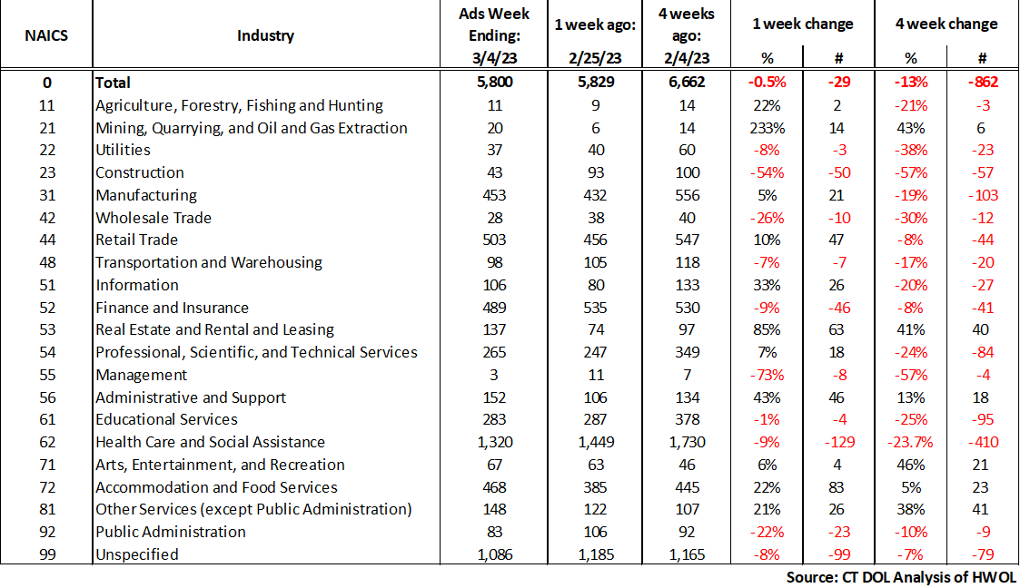
HWOL New Weekly Industry Job Ads – CT Statewide
Connecticut Department of Labor – Research Office 200 Folly Brook Blvd. Wethersfield, CT 06109
Help Wanted Online

Slide 6
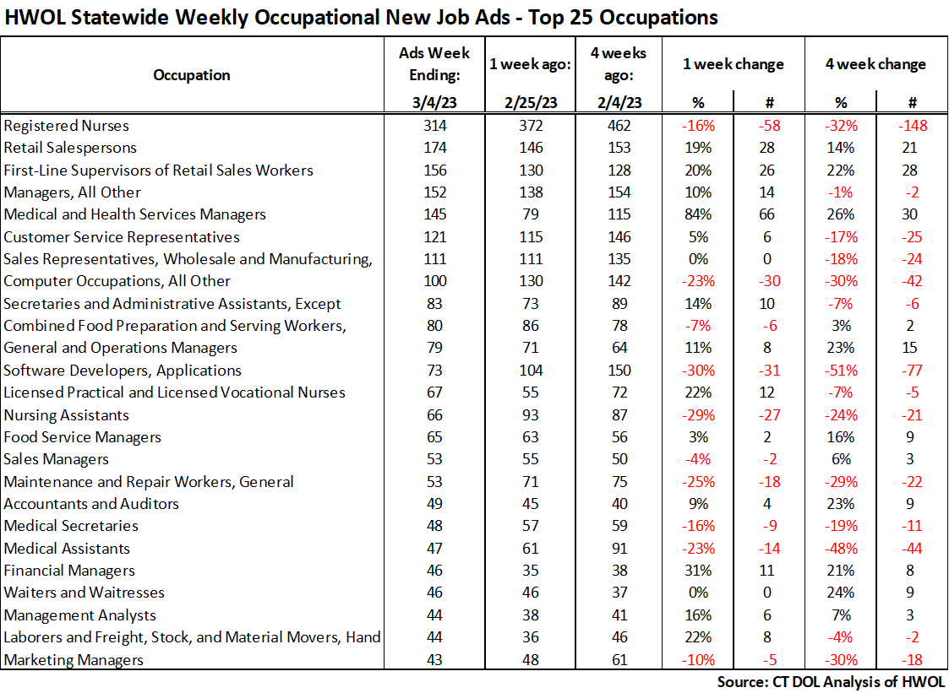
Connecticut Department of Labor – Research Office 200 Folly Brook Blvd. Wethersfield, CT 06109
Help Wanted Online

Slide 7
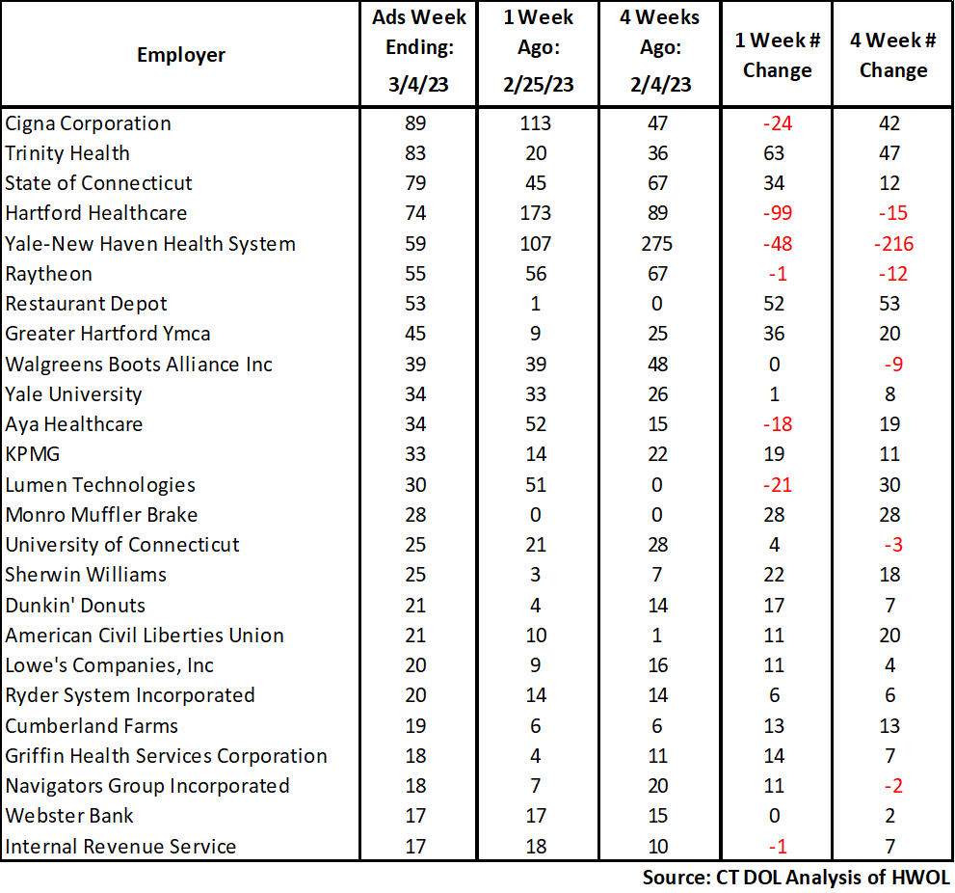
Employers with the Most New Job Postings
Connecticut Department of Labor – Research Office 200 Folly Brook Blvd. Wethersfield, CT 06109
Help Wanted Online

Slide 8
Monthly HWOL Information
The following pages contain HWOL monthly data for February 2023 Monthly and weekly job ad information can be found here: https://www1.ctdol.state.ct.us/lmi/HWOL.asp
Connecticut Department of Labor – Research Office 200 Folly Brook Blvd. Wethersfield, CT 06109
Help Wanted Online

Slide 9
Statewide Monthly Highlights
- Total postings in Connecticut was 70,915 in February 2023, down 5% from January 2023. -Industry sectors with the most job postings were Health Care and Social Assistance (18,363 postings), Manufacturing (6,251 posting), Retail Trade (6,060 postings), and Finance & Insurance (5,512 postings).
-Occupations with the most postings were Registered Nurses (4,680 postings), Retail Salespersons (1,927 postings), Managers (1,694 postings), and Wholesale & Manufacturing Sales Reps. (1,555).
Connecticut Department of Labor – Research Office 200 Folly Brook Blvd. Wethersfield, CT 06109
Help Wanted Online

Slide 10
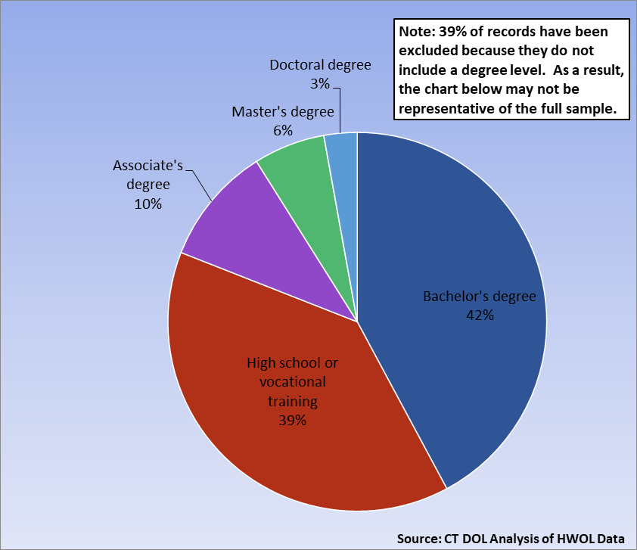
Connecticut Job Ads by Educational Requirements
Connecticut Department of Labor – Research Office 200 Folly Brook Blvd. Wethersfield, CT 06109
Help Wanted Online

Slide 11
Top Certifications in Connecticut Job Ads
Connecticut Department of Labor – Research Office 200 Folly Brook Blvd. Wethersfield, CT 06109
Help Wanted Online

Slide 12
Top Skills in Connecticut Job Ads
Connecticut Department of Labor – Research Office 200 Folly Brook Blvd. Wethersfield, CT 06109
Help Wanted Online

Slide 13
Top Skills by Industry in Connecticut Job Ads
Connecticut Department of Labor – Research Office 200 Folly Brook Blvd. Wethersfield, CT 06109
Help Wanted Online

Slide 14
Top Skills by Industry in Connecticut Job Ads (Continued)
Connecticut Department of Labor – Research Office 200 Folly Brook Blvd. Wethersfield, CT 06109
Help Wanted Online

Slide 15
Connecticut Department of Labor – Research Office 200 Folly Brook Blvd. Wethersfield, CT 06109
Help Wanted Online

Slide 16
Connecticut Employers with the Most Job Ads
Connecticut Department of Labor – Research Office 200 Folly Brook Blvd. Wethersfield, CT 06109
Help Wanted Online

Slide 17
Connecticut Occupations with the Most Job Ads
Connecticut Department of Labor – Research Office 200 Folly Brook Blvd. Wethersfield, CT 06109
Help Wanted Online

Slide 18
Connecticut Job Ads by Industry and Major Occupational Group
Connecticut Department of Labor – Research Office 200 Folly Brook Blvd. Wethersfield, CT 06109
Help Wanted Online

Slide 19
Workforce Area Data
Workforce Area Highlights
Job Ads by Industry
Job Ads by Location
Employers With The Most Job Ads
Occupations With The Most Job Ads
Connecticut Department of Labor – Research Office 200 Folly Brook Blvd. Wethersfield, CT 06109
Help Wanted Online

Slide 20
Workforce Area Highlights
Connecticut Department of Labor – Research Office 200 Folly Brook Blvd. Wethersfield, CT 06109
Help Wanted Online

Slide 21
Connecticut Department of Labor – Research Office 200 Folly Brook Blvd. Wethersfield, CT 06109
Help Wanted Online

Slide 22
Eastern Workforce Job Ads by Location
Connecticut Department of Labor – Research Office 200 Folly Brook Blvd. Wethersfield, CT 06109
Help Wanted Online

Slide 23
Eastern Workforce Employers
with the Most Job Ads
Connecticut Department of Labor – Research Office 200 Folly Brook Blvd. Wethersfield, CT 06109
Help Wanted Online

Slide 24
Eastern Workforce Occupations
with the Most Job Ads
Connecticut Department of Labor – Research Office 200 Folly Brook Blvd. Wethersfield, CT 06109
Help Wanted Online

Slide 25
Connecticut Department of Labor – Research Office 200 Folly Brook Blvd. Wethersfield, CT 06109
Help Wanted Online
25

Slide 26
North Central WDA Job Ads by Location
Connecticut Department of Labor – Research Office 200 Folly Brook Blvd. Wethersfield, CT 06109
Help Wanted Online

Slide 27
North Central WDA Employers
with the Most Job Ads
Connecticut Department of Labor – Research Office 200 Folly Brook Blvd. Wethersfield, CT 06109
Help Wanted Online

Slide 28
North Central WDA Occupations
with the Most Job Ads
Connecticut Department of Labor – Research Office 200 Folly Brook Blvd. Wethersfield, CT 06109
Help Wanted Online

Slide 29
Connecticut Department of Labor – Research Office 200 Folly Brook Blvd. Wethersfield, CT 06109
Help Wanted Online

Slide 30
Northwest WDA Job Ads by Location
Connecticut Department of Labor – Research Office 200 Folly Brook Blvd. Wethersfield, CT 06109
Help Wanted Online

Slide 31
Northwest WDA Employers
with the Most Job Ads
Connecticut Department of Labor – Research Office 200 Folly Brook Blvd. Wethersfield, CT 06109
Help Wanted Online

Slide 32
Northwest WDA Occupations
with the Most Job Ads
Connecticut Department of Labor – Research Office 200 Folly Brook Blvd. Wethersfield, CT 06109
Help Wanted Online

Slide 33
Connecticut Department of Labor – Research Office 200 Folly Brook Blvd. Wethersfield, CT 06109
Help Wanted Online

Slide 34
South Central WDA Job Ads by Location
Connecticut Department of Labor – Research Office 200 Folly Brook Blvd. Wethersfield, CT 06109
Help Wanted Online

Slide 35
South Central WDA Employers
with the Most Job Ads
Connecticut Department of Labor – Research Office 200 Folly Brook Blvd. Wethersfield, CT 06109
Help Wanted Online

Slide 36
South Central WDA Occupations
with the Most Job Ads
Connecticut Department of Labor – Research Office 200 Folly Brook Blvd. Wethersfield, CT 06109
Help Wanted Online

Slide 37
Connecticut Department of Labor – Research Office 200 Folly Brook Blvd. Wethersfield, CT 06109
Help Wanted Online

Slide 38
Southwest WDA Job Ads by Location
Connecticut Department of Labor – Research Office 200 Folly Brook Blvd. Wethersfield, CT 06109
Help Wanted Online

Slide 39
Southwest WDA Employers
with the Most Job Ads
Connecticut Department of Labor – Research Office 200 Folly Brook Blvd. Wethersfield, CT 06109
Help Wanted Online

Slide 40
Southwest WDA Occupations
with the Most Job Ads
Connecticut Department of Labor – Research Office 200 Folly Brook Blvd. Wethersfield, CT 06109
Help Wanted Online

Slide 41
All advertisement data used in this publication is from the Conference Board’s Help Wanted Online data series.
For more information or data requests, contact Matthew Krzyzek in the Office of Research at the Department of Labor.
Matthew.Krzyzek@ct.gov
For more Connecticut Labor Market Information visit:
www.ctdol.state.ct.us/lmi
https://www.facebook.com/ctlmi
Twitter: @DOL_Research
Connecticut Department of Labor – Research Office 200 Folly Brook Blvd. Wethersfield, CT 06109
Help Wanted Online

